Slide 1
Identifying Supernova Progenitors and Constraining the Explosion Channels
Schuyler D. Van Dyk
(Spitzer Science Center/Caltech)
Main members of the band: Nancy Elias-Rosa (IEEC/CSIC, Spain),
Alex Filippenko (UC Berkeley), Weidong Li, et al.

Slide 2
Evolution of Massive Stars
What do theoretical stellar evolutionary tracks predict/explain?
Ekstrom et al. (2012)
Non-rotating, solar Z

Slide 3
Evolution of Massive Stars
What do theoretical stellar evolutionary tracks predict/explain?
Rotating, solar Z models
(Ekstrom et al. 2012)
Rotating models agree better with
the revised Humphreys-Davidson
Limit on RSGs at ~25 M
(Levesque et al. 2005,
Crowther 2007)

Slide 4
Evolution of Massive Stars
What do theoretical stellar evolutionary tracks predict/explain?
Departure from standardized
Mass loss formulation
Pulsationally-driven
superwinds from RSGs, solar Z
(Yoon & Cantiello 2010)

Slide 5
Evolution of Massive Stars
What do theoretical stellar evolutionary tracks predict/explain?
Departure from standardized
Mass loss formulation
Increased mass-loss rates in
the Geneva models for
12-20 M RSGs, solar Z
(Georgy 2011)
All single-star evolution – binarity has not been taken into account !

Slide 6
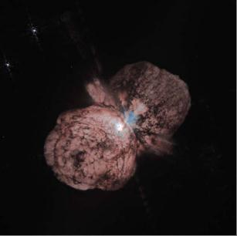
Evolution of Massive Stars
A special case: The most massive stars
Galactic Wolf-Rayet Stars (WRs)
have M_{WR} ≤ 20 M
(Crowther 2007)
Continuum-driven LBV eruptions
(Smith & Owocki 2006)
(stolen from a talk by Nathan Smith)

Slide 7
SN II-P Progenitors
The most common core-collapse SNe
“Normal” SN II-P
1999em (in NGC 1637)
Low-luminosity SNe II-P
1999br (in NGC 4900),
2008bk (in NGC 7793),
2005cs (in M51),
etc.
SN 1999br
SN 1999em
SN 2008bk
SN 2005cs
(from Van Dyk et al. 2012)

Slide 8
SN II-P 2008bk
The “second best” progenitor detection ever
Gemini-S GMOS g’r’i’ from 2007
Van Dyk et al. (2012)
also, Mattila et al. (2008)
Gemini + archival VLT ISAAC & HAWK-I
(MARCS stellar atmospheres)

Slide 9
SN II-P 2008bk
Low luminosity --- low ⁵⁶Ni mass, NSE reached in thin O/Si-rich layer around core
Super-AGB at low(er) metallicity ???
Van Dyk et al. (2012)
M _{ini} = 8 – 8.5 M

Slide 10
SN II-P Progenitors
What is the mass for the RSG progenitors of ``normal’’ SNe II-P ???
(figure from Smartt et al. 2009)

Slide 11
SN II-P Progenitors
What is the mass for the RSG progenitors of ``normal’’ SNe II-P ???
Possible high-luminosity II-P !
A constraint, not a detection !
99A/87A-like II-P (pec) *: BSG !
A constraint, not a detection !
Low-lum
II-P
Probable II-L ** !
High-luminosity II-P !
(figure from Smartt et al. 2009)
*Harutyunyan et al. (2008)
**Gallagher et al. (2010)

Slide 12
SN II-P Progenitors
What is the mass for the RSG progenitors of ``normal’’ SNe II-P ???
Smartt et al. (2009): M _{ini} < 13 M

Slide 13
High-luminosity SNe II-P
SN 2008cn in NGC 4603 (Elias-Rosa et al. 2009)
most distant direct identification, at 33 Mpc
A_{V}=1.08 mag; Z=0.02
Yellow supergiant (!) with M _{ini} = 15 ± 2 M
These could also include SN 2004et and, possibly, SN 1999ev

Slide 14
High-luminosity SNe II-P
SN 2004et in NGC 6946
Van Dyk & Jarrett (2012, in prep.)
Lejeune & Schaerer (2001) model
loses ~1 M

Slide 15
SN II-L Progenitors
SN 2009kr in NGC 1832 (Elias-Rosa et al. 2010)
A_{V}=0.25 mag
d= 26 Mpc
Z=0.02
Yellow supergiant (!) with M _{ini} = 18 –24 M
(see also Fraser et al. 2010; M _{ini} = 15 ⁺⁵ ₋₄ M)

Slide 16
SN II-L Progenitors
SN 2009kr in NGC 1832 (Elias-Rosa et al. 2010)
Yoon & Cantiello (2010)
track
Ekstrom et al. (2012)
tracks
Yellow supergiant with M _{ini} ≈ 19 –20 M?

Slide 17
SN II-L Progenitors
SN 2009hd in M66 (Elias-Rosa et al. 2011)
Hubble Legacy Archive data
from 1997 - 1998
d =9.4 Mpc A_{V} ≈ 3.8 mag
F555W
F814W
At M_{V} (max) = -17.2 mag, SN 2009hd is probably a SN II-L

Slide 18
SN II-L Progenitors
SN 2009hd in M66 (Elias-Rosa et al. 2011)
Geneva tracks
Yoon & Cantiello
track
Z=0.02
Yellow or red supergiant (?) with M _{ini} ≤ 20 M

Slide 19
SN IIb Progenitors
SN 2011dh in M51
A_{v}=0.12 mag, d = 7.7 Mpc
Van Dyk et al. (2011)
WN
progenitor
companion
Z=0.02
HLA data
from 2005
Keck-II NIRC2 AO
Maund et al. (2011) claim that the F-type supergiant is the progenitor
however, SN 2011dh had a compact progenitor (Arcavi et al. 2011)

Slide 20
SN IIn Progenitors
SN 2005gl in NGC 266 (d = 66 Mpc)
(Gal-Yam et al. 2007; Gal-Yam & Leonard 2009)
HST WFPC2 F547M
M_{V} ≈ -10.3 mag (!!)
Keck-II NIRC2 AO
HST WFPC2 F547M

Slide 21
SN Ib Progenitors
SN Ib 2009jf in NGC 7479 (Van Dyk et al., in prep.)
A_{V}= 0.53 mag, d = 33.9 Mpc
HST/WFPC2 F569W from 1995
HST/ACS F555W

Slide 22
SN Ib Progenitors
Comparison of the
bolometric light curve
for SN 2009jf
with the models by
Dessart et al. (2011)
The light curve is
consistent with
the close binary model
with a primary of
M_{ini} = 18 M
and M_{fin} = 3.79 M
WN star
Secondary has
Mini = 17--23 M
(Yoon, Woosley, & Langer 2010)
SN Ib
(Van Dyk et al., in prep.)

Slide 23
SN Ib Progenitors
SN Ib 2009jf in NGC 7479 (Van Dyk et al., in prep.)
Combined
light
Secondary
Evolution of the primary
Primary
terminus
Yoon, Woosley, & Langer (2010)

Slide 24
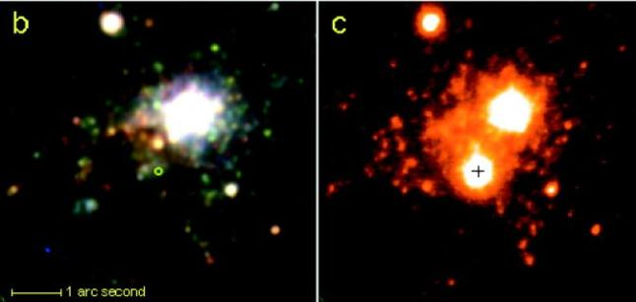
SN Ic Progenitors
SN Ic 2004gt in NGC 4038 (Gal-Yam et al. 2005; Maund et al. 2005)
HST
AO
Not very restrictive limits, based on detection limits/star cluster properties

Slide 25
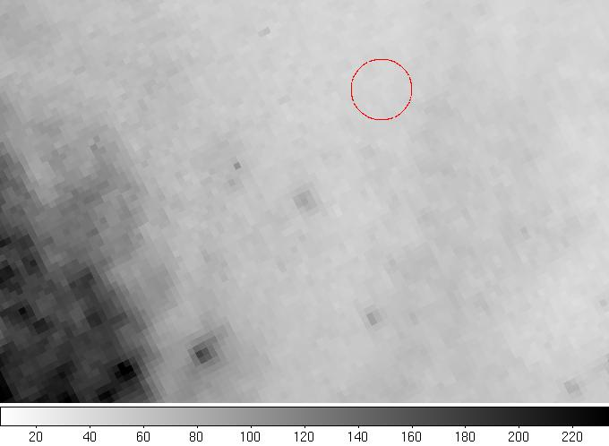
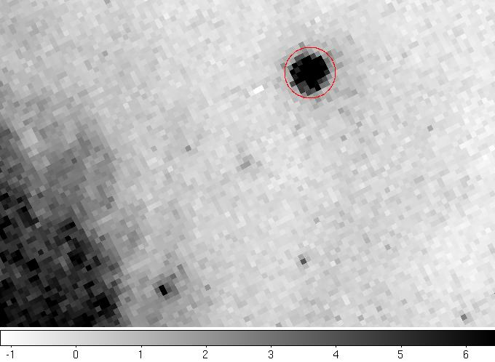
SN Ic Progenitors
SN Ic 2003jg in NGC 2997
A_{V,tot} ≈ 4 mag
Subsections of NGC 2997 before (left - HST/WFPC2) and after (right - HST/ACS-HRC) the SN 2003jg explosion, in F814W. The position of the SN is indicated by a circle

Slide 26
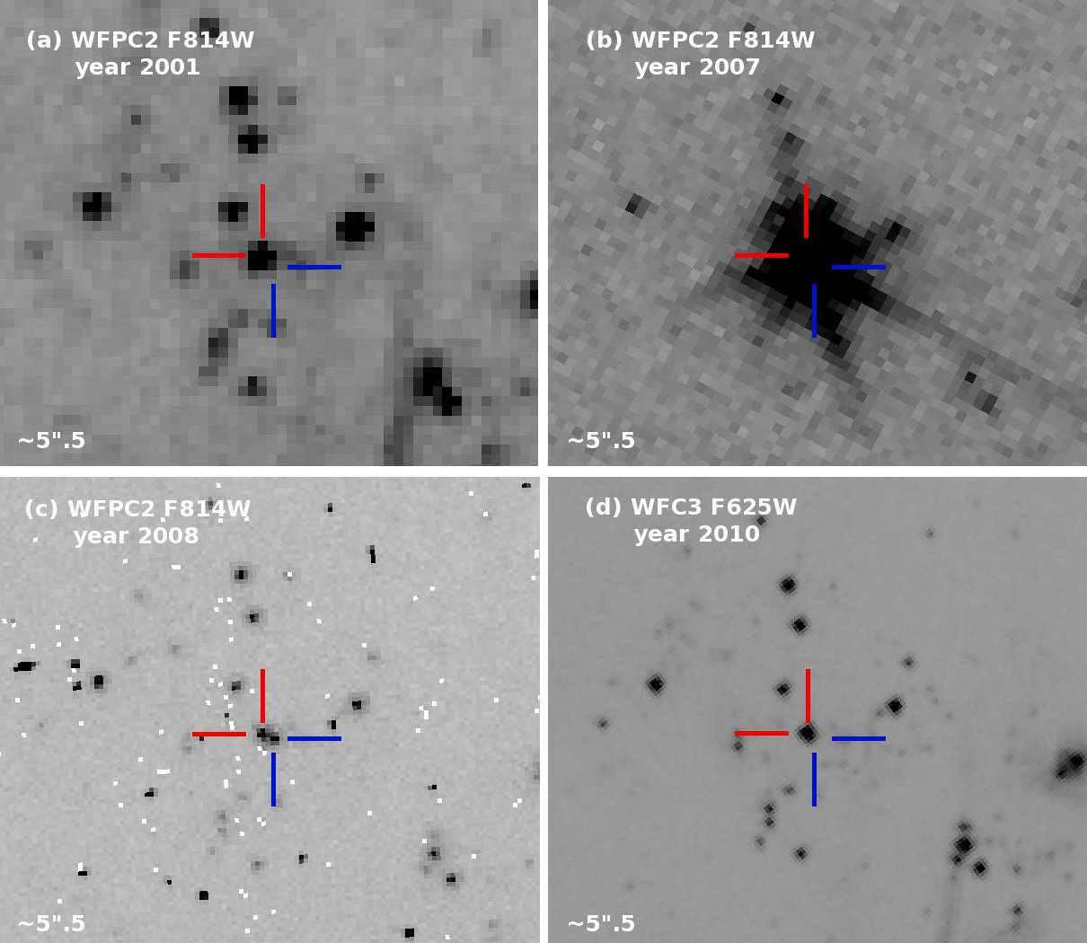
SN Ic Progenitors
SN Ic 2007gr in NGC 1058
d=9.3 Mpc, A_{V,tot} ≈ 0.3 mag
WFC2 chip
PC chip
PC chip
(also
Crockett et al. 2008)

Slide 27
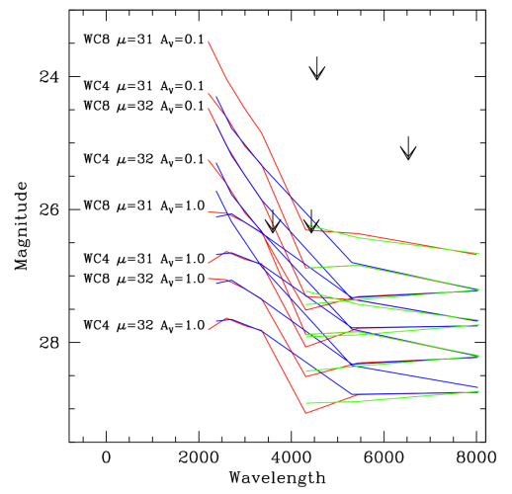
SN Ic Progenitors
WC star detectability
SN 2007gr
(Crockett et al. 2008)
SN 2002ap
(Crockett et al. 2007)
ground-based
L. Smith
WFC3 F336W
survey
Sander et al. (2012)
Red = WFPC2
Blue = WFC3
Green = ACS/WFC

Slide 28
Explosion Channels
Progression of progenitor initial mass related to stripping of H envelope (… binarity?)
Current evolutionary tracks do not adequately predict observed pre-SN stars
low-luminosity SNe II-P have M_{ini} = 8--9 M: lower ⁵⁶Ni mass --- super-AGB? Metallicity effect?
M_{ini} < 15 M for `normal’ SN II-P RSG progenitors? We need a direct progenitor detection!
High-luminosity SNe II-P may arise from YSGs with M_{ini} > 15 M (??)
SNe II-L may also arise from YSGs, with M_{ini} ≈ 20 M (??)
Envelope has been stripped --- dense circumstellar matter, leading to radio/X-ray emission
Some SNe IIn arise from LBVs, i.e., very high-mass stars (see also Kiewe et al. 2012)
very heterogeneous type
SNe IIb may have high-mass extended or compact progenitors (stripped components in interacting binaries)
SNe Ib may have similar high-mass compact (WR) progenitors in binaries
SNe Ic: high-mass, single WC stars … or binaries ????

